Slide 1
CATEGORICAL DATA ANALYSIS PROJECT
ADHIRAJ ROKA
4/27/2020

Slide 2
BACKGROUND ON DATA
The dataset is a subset of the 1987 National Indonesia Contraceptive Prevalence Survey taken from married women who were not pregnant at the time of the interview .
Response variable: Contraceptive method used by women : 3 Categories:
1-No Use, 2-Long-term use and 3-Short-term use
Explanatory variables: Age- women’s age in years,
Education- education level 1: low, 2: medium, 3: medium-high, 4: high,
Children- Number of children,
Religion: 0: Non-Islam, 1: Islam,
Employed- Employment status, 0: Yes, 1: No,
Index- Standard of living Index 1: low, 2: medium, 3: medium-high, 4: high,
Media Exposure- 0: Good exposure, 1: Not a Good exposure

Slide 3
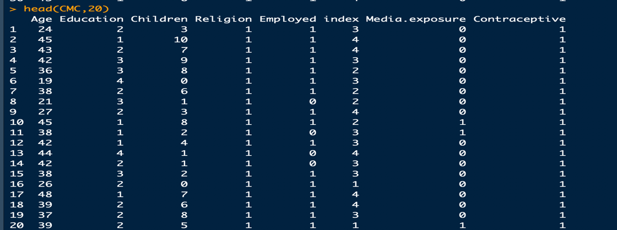
MOTIVATION
Interested in finding out what type of contraceptive methods are used by women.
This information is valuable to help discern what kind of women are using birth control,
It could be used to create target marketing campaigns or help improve a products appeal to specific types of women.

Slide 4
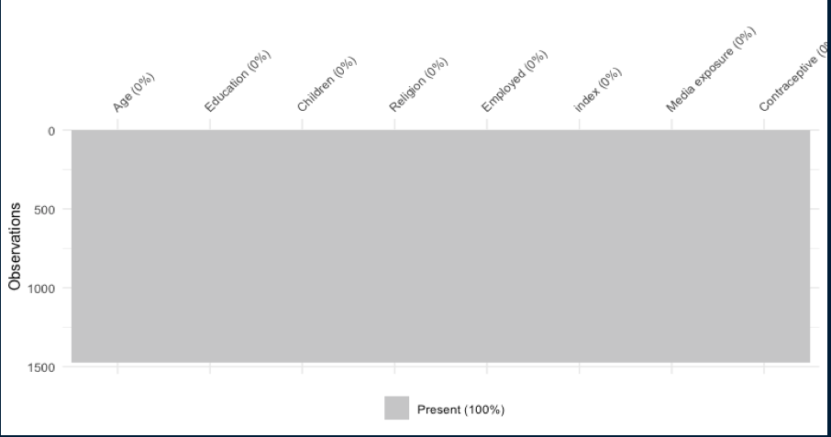
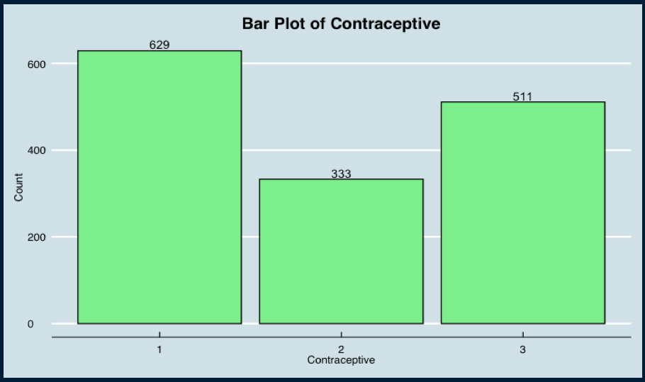
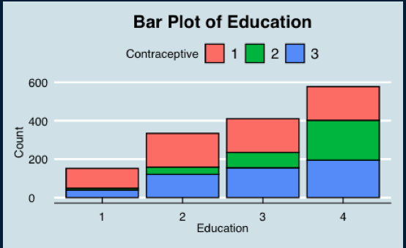
ANALYSIS
No missing values- fairly clean data.
No use-1 of contraception has highest count
As education level for women increases, proportion
of No use and Short and Long-term use evens out

Slide 5
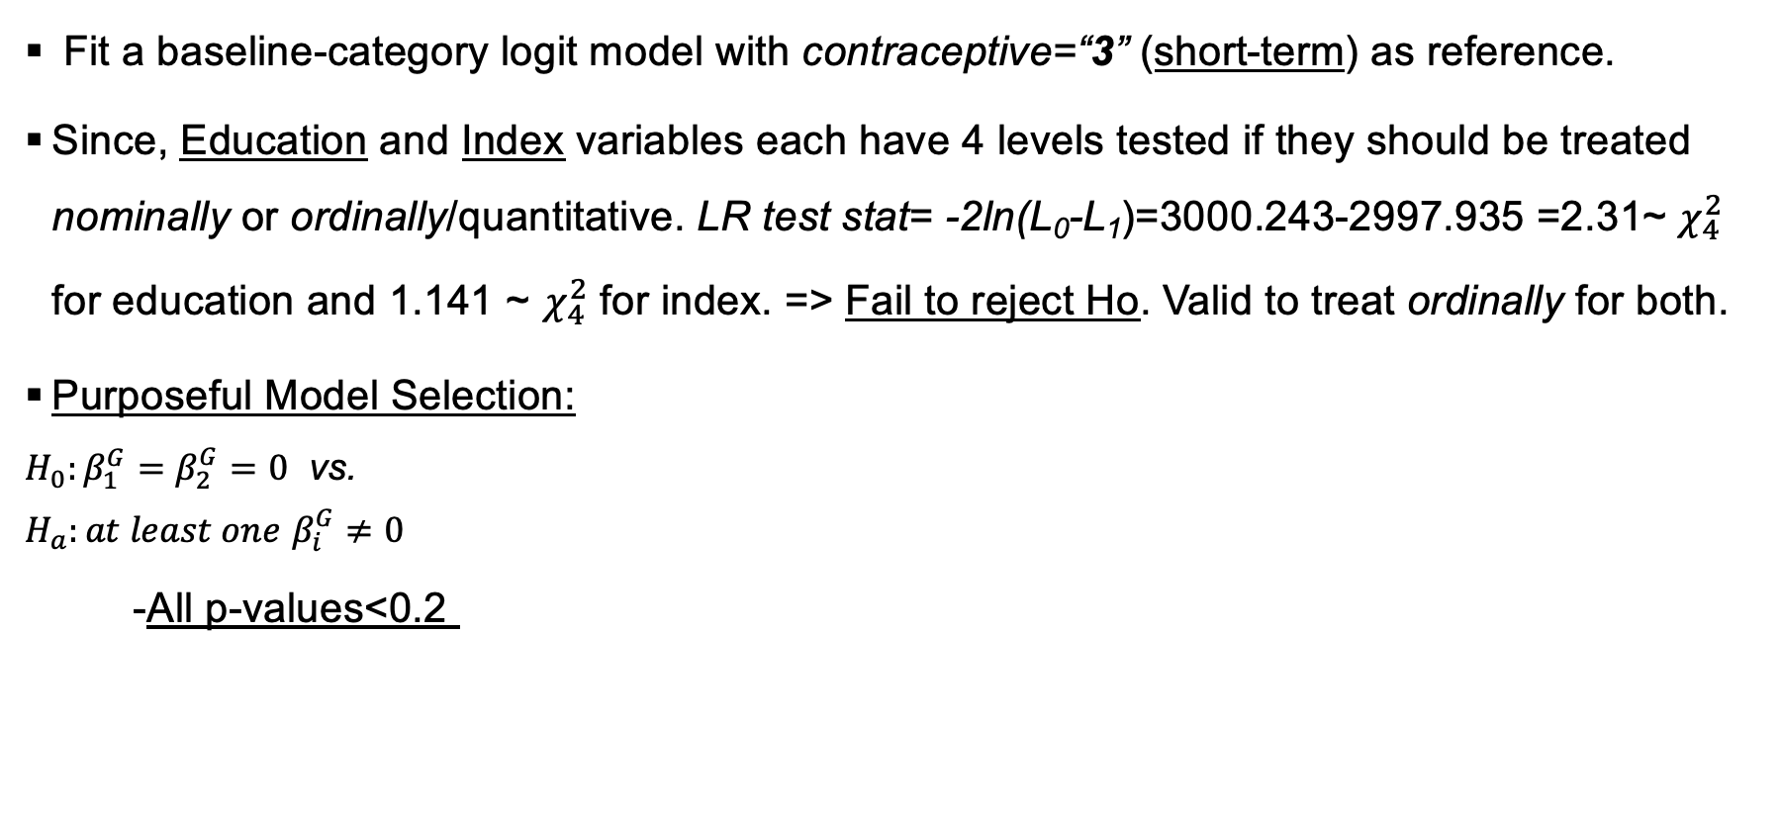
Model Selection
Predictors | LRT-stat (DF) | P-value
Age | 65.52 (2) | <0.0001
Education | 142.48 (2) | <0.0001
Children | 26.47 (2) | <0.0001
Religion | 20.05 (2) | <0.0001
Employed | 5.27 (2) | 0.0716
Index | 65.24 (2) | <0.001
Media Exposure | 32.23 (2) | <0.001

Slide 6
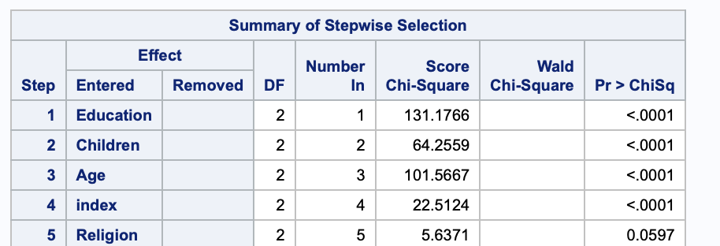
Forward Stepwise Selection with α entry and stay =0.1 for 2nd step
Employed and Media Exposure was removed.
Added in any variables that were not included in the model, i.e. Employed and Media Exposure . A predictor can be added in even if p-value>0.1 if the least coefficient change by at least 10% for the 3rd step.

Slide 7
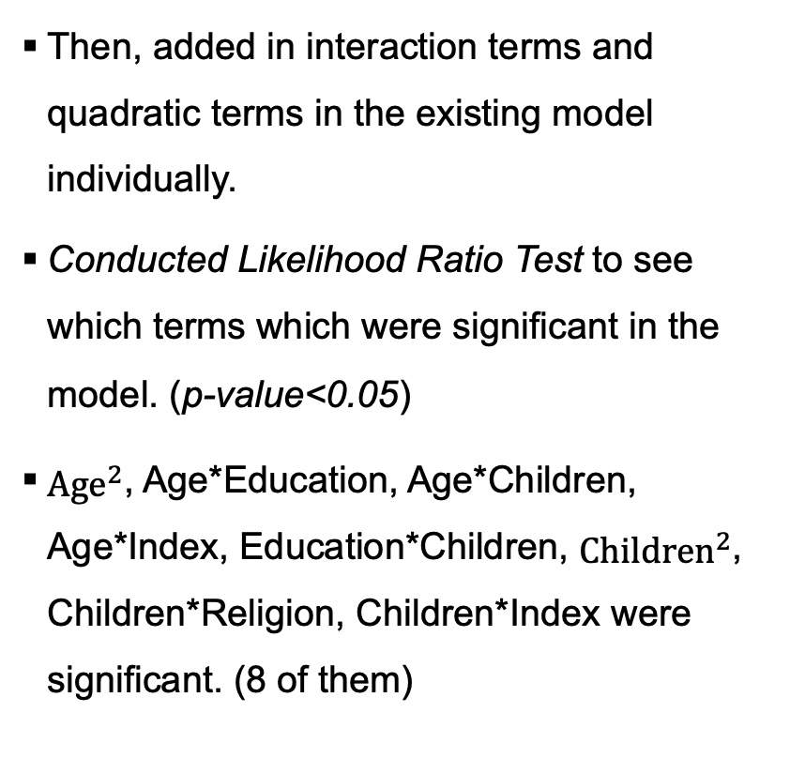
Interactions/Quadratic effect | LRT-stat (df) | P-value *
 | 33.694 (2) | <0.0001
Age*Education | 14.437 (2) | 0.0055
Age*Children | 59.411 (2) | <0.0001
Age*Index | 8.18 (2) | 0.017
Education*Children | 12.193 (2) | <0.0001
 | 112.706 (2) | <0.0001
Children*Religion | 8.615 (2) | 0.0134
Children*Index | 9.539 (2) | 0.0085

Slide 8
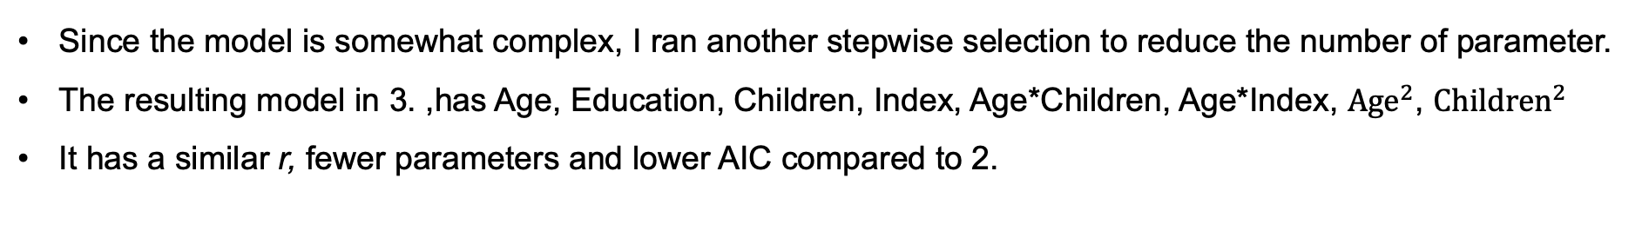
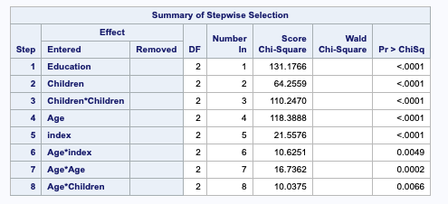
Let Age-A , Education- E, Children- C, Religion- R, Index= I
 | Model (predictors) | AIC | Correlation coefficient, r
1. | A+E+C+R+I | 2820.993 | 0.457
2. |  | 2694.803 | 0.538
3. |  | 2686.448 | 0.533
4. |  | 2769.612 | 0.488

Slide 9
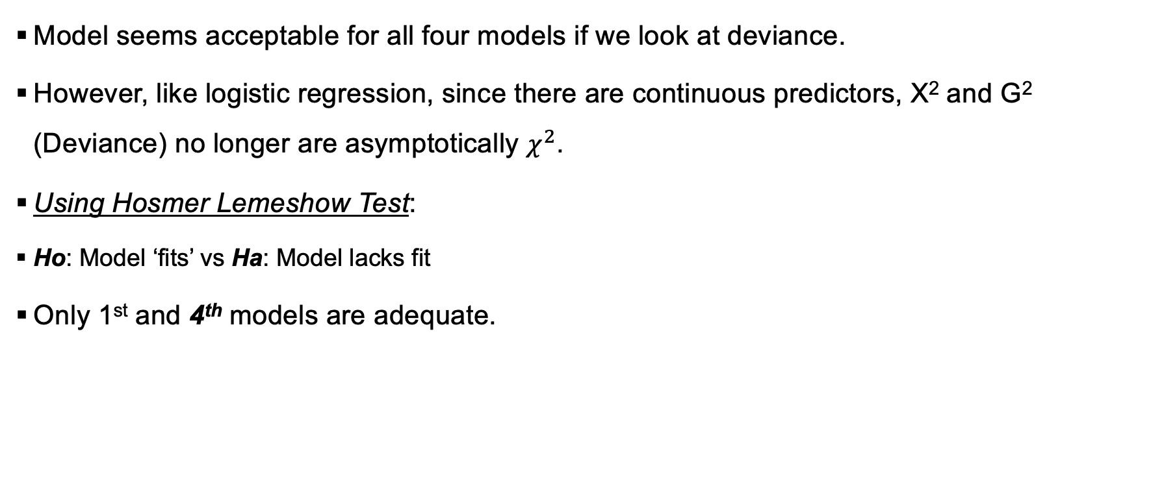
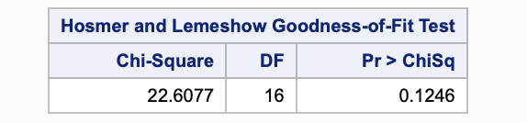
Model Diagnostics
 | Hosmer-Lemeshow Test (models) | Chi.sq| DF | P-value
1. | A+E+C+R+I | 23.21| 16 | 0.1081*
2. |  | 34.78| 16 | 0.0043
3. |  | 34.66| 16 | 0.0044

Slide 10
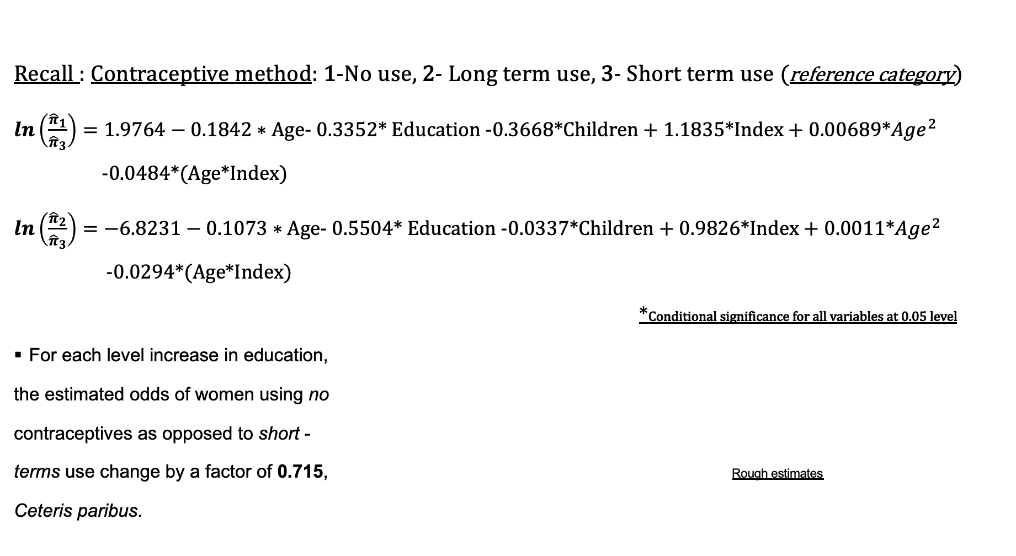
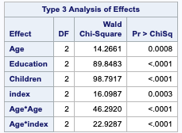
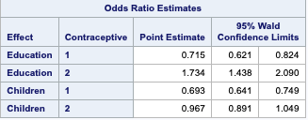
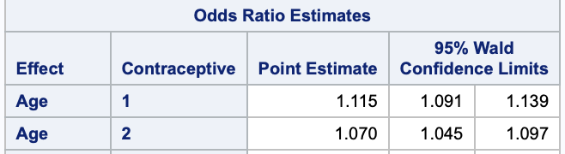


Slide 11
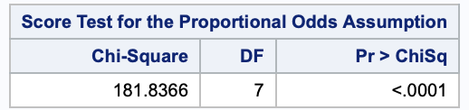
Continued
Test for Education and Index variables again in final model
H₀: ordinal treatment of variable is reasonable
H_{a}: categorical treatment of variable is necessary
From the table, Fail to reject Ho. Valid to treat ordinally for both.
CUMULATIVE LOGIT proportional odds:
H₀: Proportional Odds Model is ok vs. Ha: Proportional Odds Assumption isn’t reasonable
Clearly, proportional odds assumption is not reasonable here.
 | LRT stat|( DF) | P-value
education | 2741.612- 2740.388=1.22 (4) | 0.87
index | 2741.612-2736.345 =5.27 (4) | 0.26

Slide 12
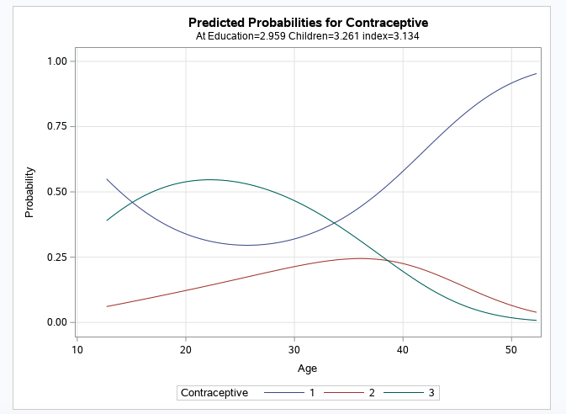
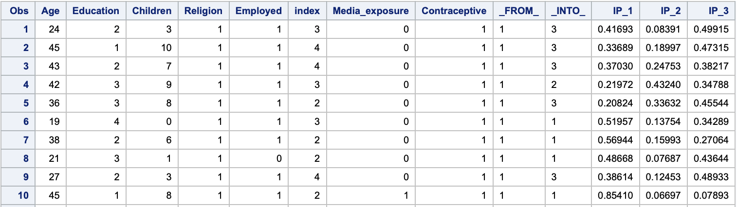
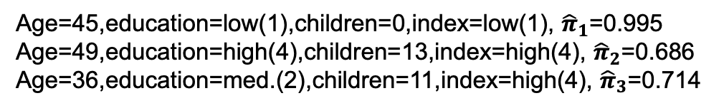
Predicted Probabilities/Some Findings
From the graph:
From late teens to early 30s, the dominant method of contraception is short term over no contraceptives
and long-term use.
Women in their late 30s and onward are more likely to use no contraceptives than either short-term or
long-term.

Slide 13
Limitations
It is important to consider this data is dated in 1987
Contraception methods have become safer and more varied in the last several years
the data collected/results could be possibly varied than data that could be collected today

